Slide 1
Smart Monitoring And Safety System Phase 1

Slide 2
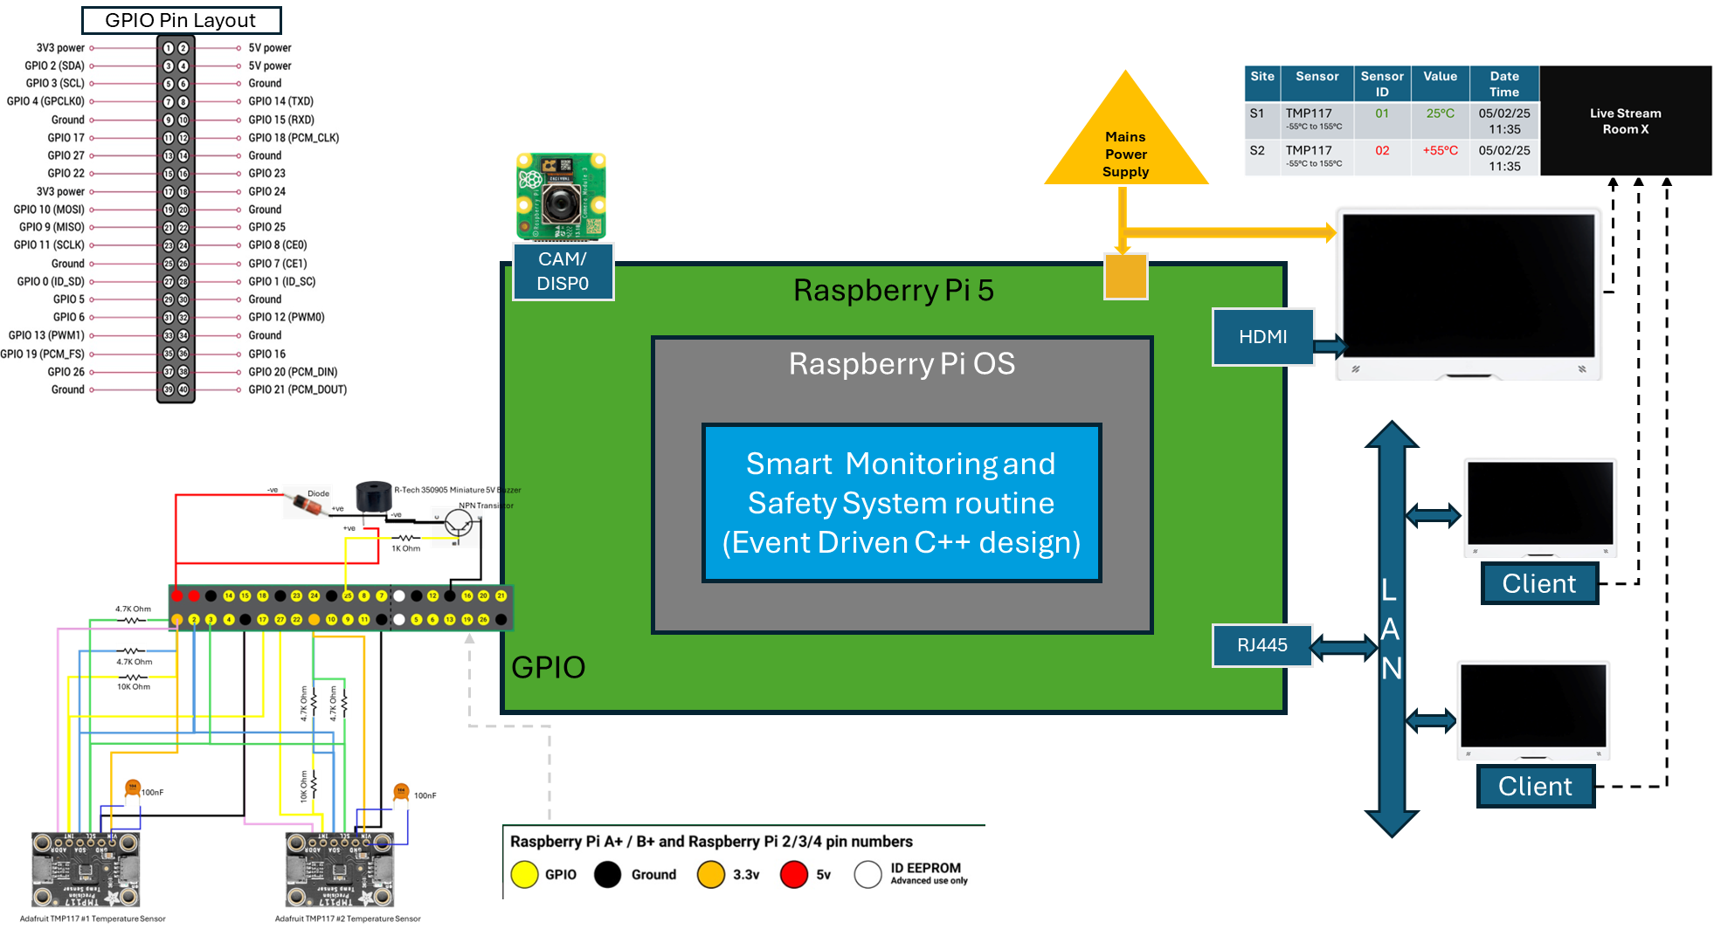

Slide 3
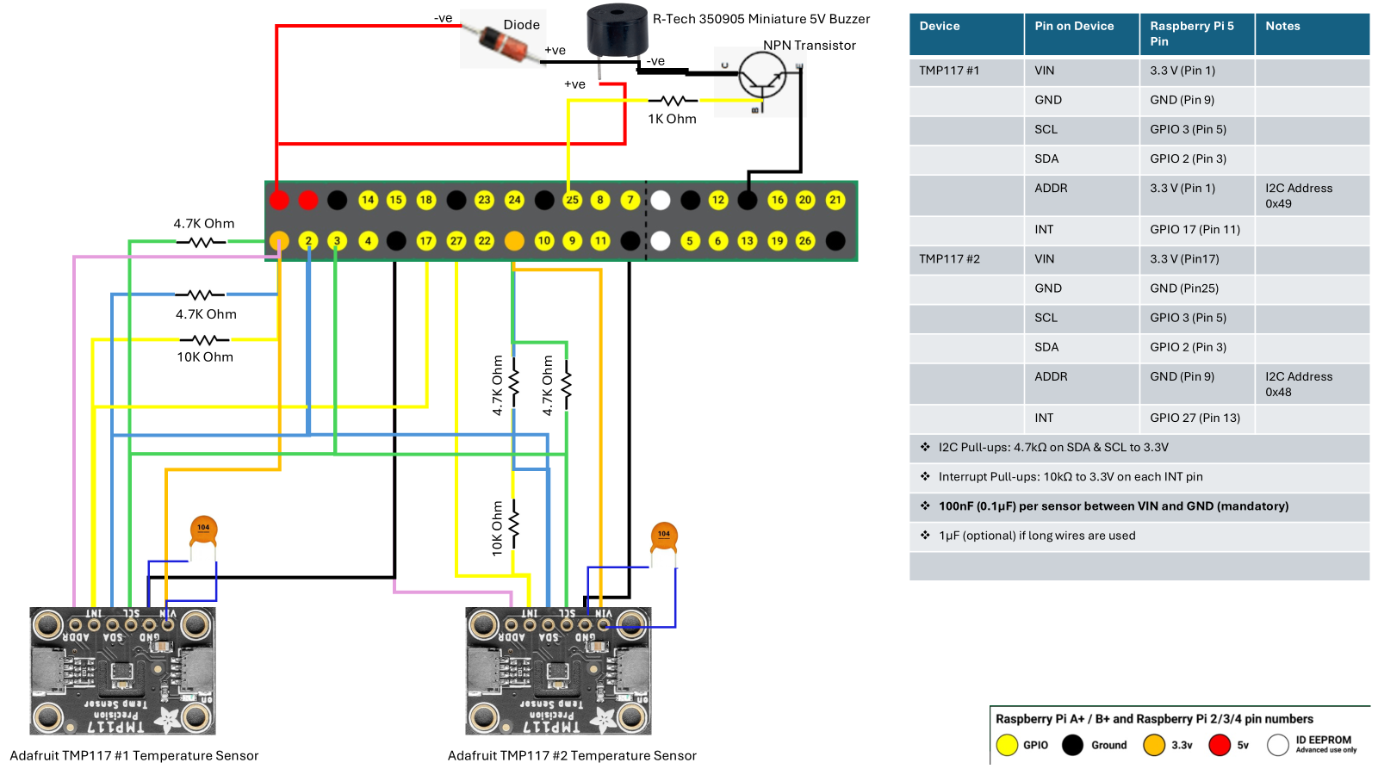

Slide 4
GPIO Devices wiring diagram
Device | Pin on Device | Raspberry Pi 5 Pin | Notes
TMP117 #1 | VIN | 3.3 V (Pin 1)
 | GND | GND (Pin 9)
 | SCL | GPIO 3 (Pin 5)
 | SDA | GPIO 2 (Pin 3)
 | ADDR | 3.3 V (Pin 1) | I2C Address 0x49
 | INT | GPIO 17 (Pin 11)
TMP117 #2 | VIN | 3.3 V (Pin17)
 | GND | GND (Pin25)
 | SCL | GPIO 3 (Pin 5)
 | SDA | GPIO 2 (Pin 3)
 | ADDR | GND (Pin 9) | I2C Address 0x48
 | INT | GPIO 27 (Pin 13)
HC-SR501 | VCC | 5V (Pin 2)
 | GND | GND (Pin 6)
 | OUT | GPIO 23 (Pin 16)
I2C Pull-ups: 4.7kΩ on SDA & SCL to 3.3V
Interrupt Pull-ups: 10kΩ to 3.3V on each INT pin
100nF (0.1µF) capacitor between VIN and GND of each TMP117 sensor (mandatory)
1µF (optional) if long wires are used
Component | Connection
Buzzer +ve (VCC) (long leg) | 5V (Pin 2)
Buzzer -ve (GND) (short leg) | Collector of transistor
Emitter of transistor | GND (Pin 34)
Base of transistor | Through 1kΩ resistor to GPIO 25 (Pin 22)
Diode (1N4007/1N4148) | Parallel with buzzer (Cathode to 5V, Anode to transistor collector)
Transistor (e.g., 2N2222, BC547) acts as a switch
1kΩ Resistor limits the current to the transistor’s base
Buzzer turns ON when GPIO 25 is set HIGH

Slide 5
Smart Monitoring And Safety System Phase 2 - Addition of HC-SR501 PIR motion sensor

Slide 6
